Slide 1
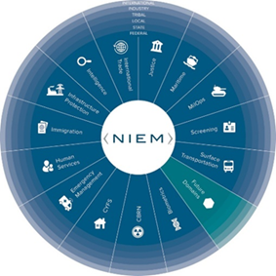
NBAC Annual Meeting
DOMAIN UPDATES

Slide 2
Domain participation during annual meeting (instructions)
On Thursday, 16 Sep 21 during the 1:05 - 1:50 PM timeslot, each domain will be called on to provide a summary of their 2021 highlights and 2022 objectives. Expect about 5 – 7 minutes for each domain. A template is attached (next slide) for your convenience.
Please complete the template and return it to Steve Sullivan ​no later than 9 September. You may include additional slides as you see fit.
If you have questions, please contact:
Kamran Atri - katri@A4SAFE.COM
Thomas Krul - thomas.krul@forces.gc.ca , thomas_krul@hotmail.com , thomas.krul@ecn.forces.gc.ca
Steve Sullivan - stephen.m.sullivan14.ctr@mail.mil

Slide 3

Maritime Domain Update
Domain Steward & Stakeholders: Navy Information Warfare, Office of Naval Intelligence
Description
2021 Highlights: Explore opportunities to use NIEM 2022 Objectives: continue exploration and participate in `best practices’ activities NIEM Recommendations: Widely distribute practical standards (a.k.a. de facto best practices)
2021 Highlights
2022 Objectives
NIEM Recommendations
Conducted the 03-15AUG LSE21 that tested "war-fighting concepts that are not fully refined," across 17 time zones with 30+ live, 50+ virtual / constructive units.
Jupiter (Advana) 2.0 dashboards demonstrated better ability to access, correlate, visualize and model data in various forms throughout the DoN.
Continued investments in network modernizations and PED improvements.
Publishing SNI 5000.36B establishing guiderails for strategic use of data
Leverage afloat opportunities to improve associated management, automations, monitoring and interoperations. And derive inferences and insights to support timely and accurate decision making.
“Plug into JADC2” to develop the networks, infrastructure, data architecture, tools, and analytics” to support Distributed Maritime Operations.
Publish SECNAVINST 5000.36B
Maximize the use of de-facto best practices (e.g. NIEM-M “lite”) to expand participation and gain insights from data exposure via machine-to-machine interfaces.
Incorporate more live, virtual and constructed interoperability experiments.
Leverage emerging capabilities against legacy systems to maximize benefit indicators (More best practices using whatever works works).

